Slide 1
Introduction to Flow Matching
Presenter: Kim Seung Hwan (seunghwan.kim@snu.ac.kr)
NCIA 인공지능 석사과정 25

Slide 2
Generative Model
What is the generative model?

Slide 3
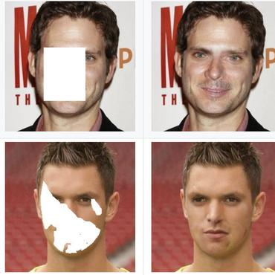
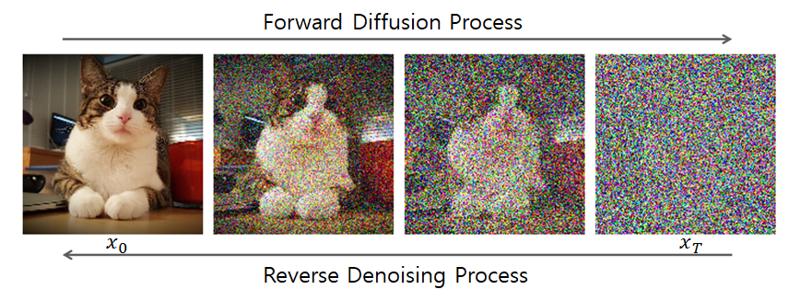
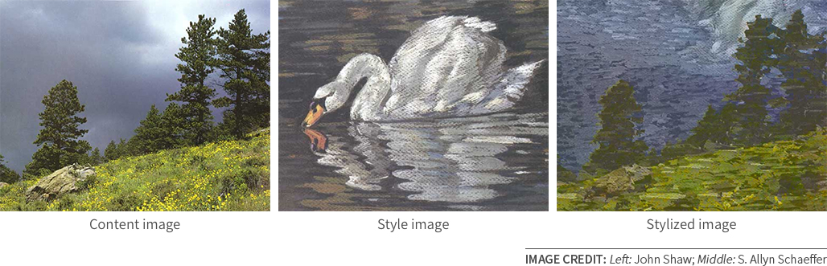
Generative Model
What is the generative model?
A mapping between probabilistic distribution.
Stylization
Sampling
Inpainting

Slide 4
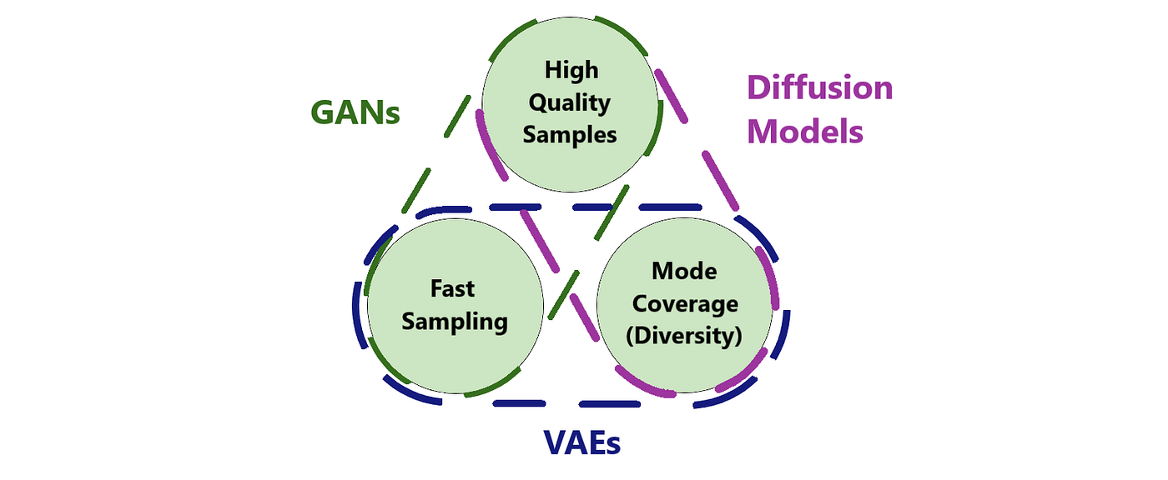
Architecture
There is a trade-off!

Slide 5
Architecture
There is a trade-off!

Slide 6
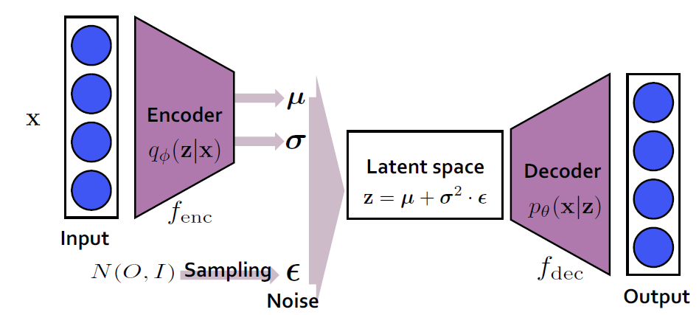
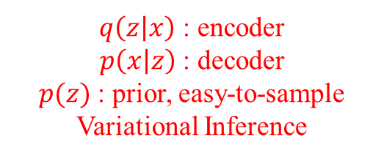
Variational Autoencoder
Is not only simple but also attractive from a theoretical perspective
Good at downstream tasks, since it does “compression.”
e.g. generating embedding which is semantically orthogonal, etc.
Very easy and cheap
BUT poor performance…
$q\left(z | x\right)$ : encoder
$p\left(x | z\right)$ : decoder
$p(z)$ : prior, easy-to-sample
Variational Inference

Slide 7
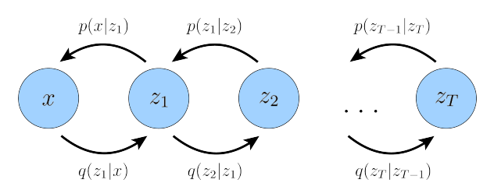
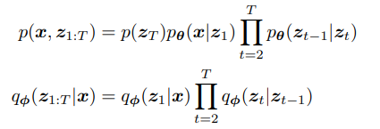



Diffusion Model
Splendid performance with well-designed modeling
Currently crowded field
BUT expensive to train
Popular field can be a disadvantage
$$q\left(x_{t} | x_{0}\right)∼N$$
$$q\left(x_{t} | x_{t−1}\right)∼N$$
Since $X∼N;Y∼N$
$$→X+Y∼N$$
Because it’s Markov chain!

Slide 8
Flow Model
Flow model is something in between
It starts from VAE, so it is very simple
While generalizing diffusion
Also, there is still a lot of room for improvement (at least in my op.)

Slide 9
Introduction to Flow Model
In fact, the flow model was proposed quite a long time ago
But it did not gain popularity because of the limitation of requiring the inverse (quite strong constraints!)
It has recently overcome this limitation and shown strong performance
We will look at the development process of the flow model

Slide 10

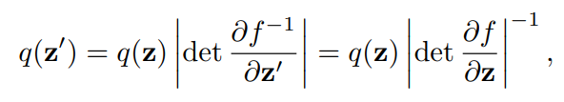
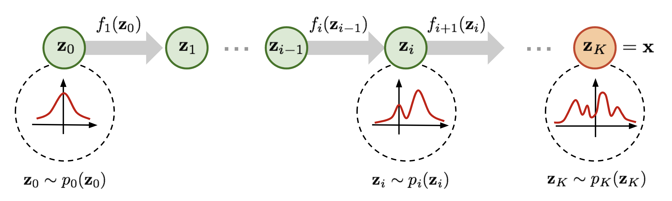
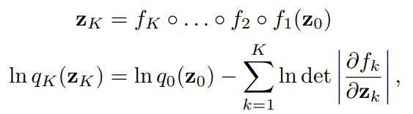

Normalizing Flow
Variational inferences using VAE suffers approximation error
e.g. mean-field approx. $q\left(z | x\right)=\prod_{i}{q(z_{i}|x)}$
Propose training diffeomorphism $f:ℝ^{n}$ (prior) $→ℝ^{n}$ (data)
Rezende, Danilo, and Shakir Mohamed. "Variational inference with normalizing flows." International conference on machine learning. PMLR, 2015.

Slide 11
Normalizing Flow
Variational inferences using VAE suffers approximation error
e.g. mean-field approx. $q\left(z | x\right)=\prod_{i}{q(z_{i}|x)}$
Propose training diffeomorphism $f:ℝ^{n}$ (prior) $→ℝ^{n}$ (data)
typically, resulting in $q\left(z | x\right)∼N\left(μ\left(x\right),diag\left(σ\left(x\right)\right)\right)$
Rezende, Danilo, and Shakir Mohamed. "Variational inference with normalizing flows." International conference on machine learning. PMLR, 2015.

Slide 12
Normalizing Flow
Variational inferences using VAE suffers approximation error
e.g. mean-field approx. $q\left(z | x\right)=\prod_{i}{q(z_{i}|x)}$
Propose training diffeomorphism $f:ℝ^{n}$ (prior) $→ℝ^{n}$ (data)
typically, resulting in $q\left(z | x\right)∼N\left(μ\left(x\right),diag\left(σ\left(x\right)\right)\right)$
Using this, the exact likelihood can be calculated
Rezende, Danilo, and Shakir Mohamed. "Variational inference with normalizing flows." International conference on machine learning. PMLR, 2015.

Slide 13
Normalizing Flow
Variational inferences using VAE suffers approximation error
e.g. mean-field approx. $q\left(z | x\right)=\prod_{i}{q(z_{i}|x)}$
Propose training diffeomorphism $f:ℝ^{n}$ (prior) $→ℝ^{n}$ (data)
typically, resulting in $q\left(z | x\right)∼N\left(μ\left(x\right),diag\left(σ\left(x\right)\right)\right)$
However, the architecture will be limited
Using this, the exact likelihood can be calculated
Rezende, Danilo, and Shakir Mohamed. "Variational inference with normalizing flows." International conference on machine learning. PMLR, 2015.

Slide 14
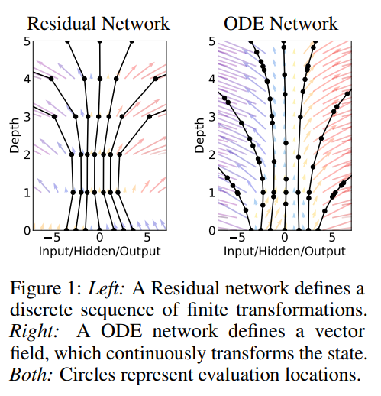
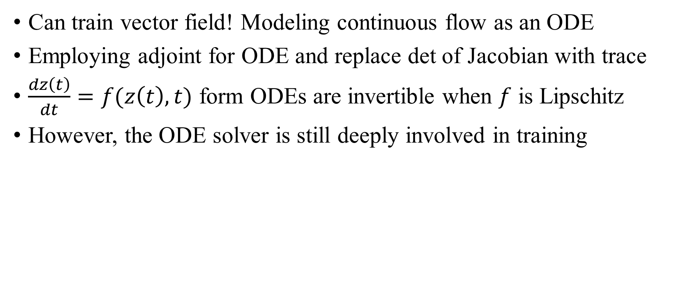
Neural ODE (Continuous NF)
Can train vector field! Modeling continuous flow as an ODE
Employing adjoint for ODE and replace det of Jacobian with trace
$\frac{dz\left(t\right)}{dt}=f(z\left(t\right),t)$ form ODEs are invertible when $f$ is Lipschitz
However, the ODE solver is still deeply involved in training
Chen, Ricky TQ, et al. "Neural ordinary differential equations." Advances in neural information processing systems 31 (2018).

Slide 15
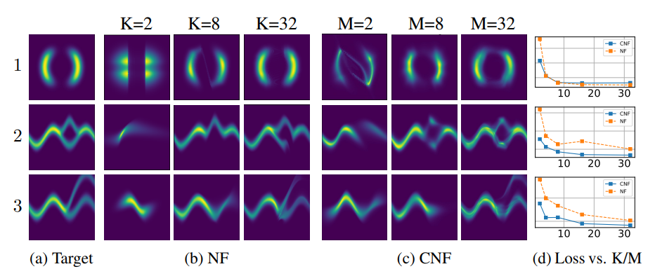
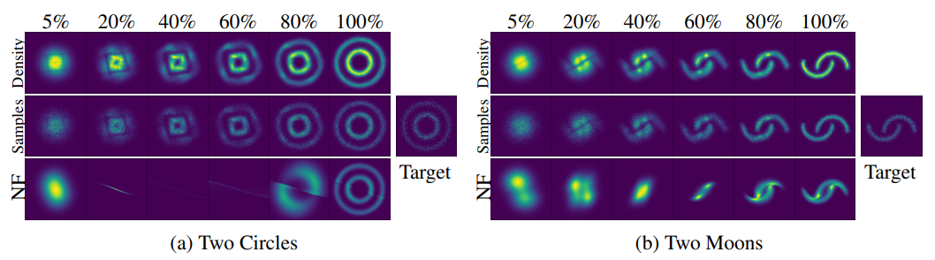
Neural ODE (Continuous NF)
Can train vector field! Modeling continuous flow as an ODE
Employing adjoint for ODE and replace det of Jacobian with trace
$\frac{dz\left(t\right)}{dt}=f(z\left(t\right),t)$ form ODEs are invertible when $f$ is Lipschitz
However, the ODE solver is still deeply involved in training

Slide 16
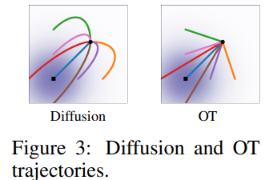


Flow Matching
Do not simulate ODE, train vector field directly
Need to know the location of $X_{t}$
It is okay to simply set $X∼N(tX_{1}+\left(1−t\right)X_{0}, σ^{2})$
Applying Wiener process to $X_{t}$, it becomes Diffusion! (SDE solver)
Lipman, Yaron, et al. "Flow Matching for Generative Modeling." The Eleventh International Conference on Learning Representations. (’23)

Slide 17
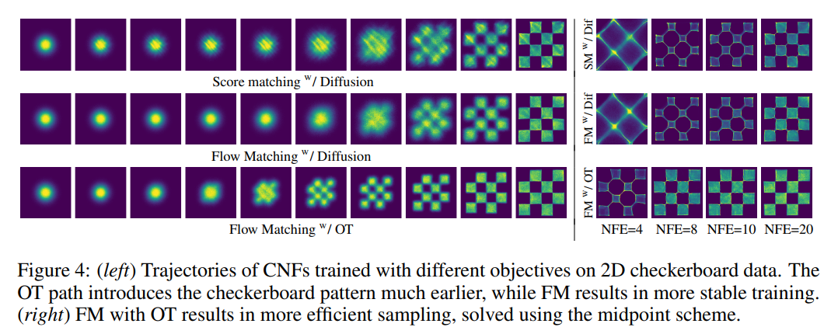
Flow Matching
Do not simulate ODE, train vector field directly
Need to know the location of $X_{t}$
It is okay to simply set $X∼N(tX_{1}+\left(1−t\right)X_{0}, σ^{2})$
Applying Wiener process to $X_{t}$, it becomes Diffusion! (SDE solver)
So, it generalizes Diffusion
And it is less noisy and clear

Slide 18
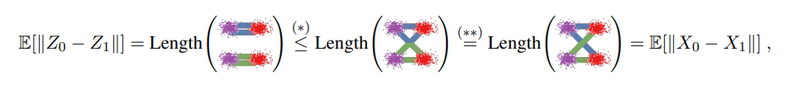
Rectified Flow
Straight path (linear interpolation) has great properties
With (almost) straight path, (almost) one-step Euler can sample!
By repeatedly training (ReFlow), one can intentionally straighten
Connection with optimal transport theory
Liu, Xingchao, and Chengyue Gong. "Flow Straight and Fast: Learning to Generate and Transfer Data with Rectified Flow." The Eleventh International Conference on Learning Representations. (‘23)

Slide 19
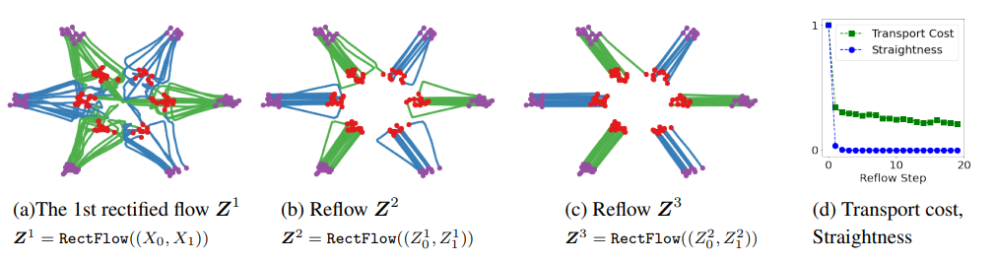
Rectified Flow
Straight path (linear interpolation) has great properties
With (almost) straight path, (almost) one-step Euler can sample!
By repeatedly training (ReFlow), one can intentionally straighten
Connection with optimal transport theory

Slide 20
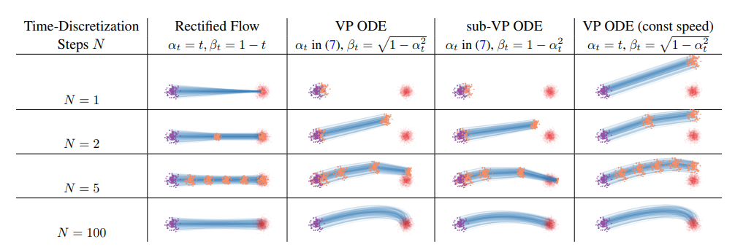
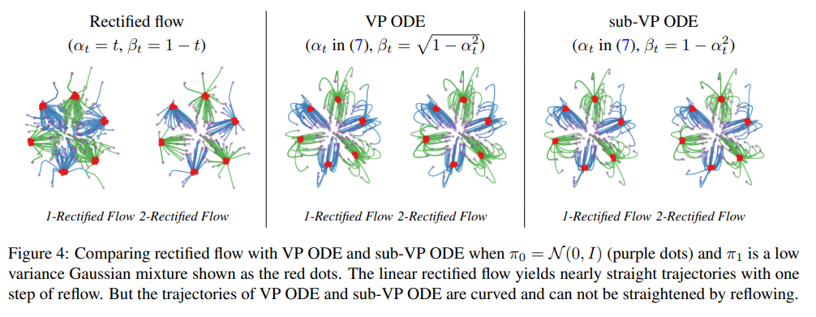
Rectified Flow

Slide 21
Further Studies…
Optimal transport
Kornilov, Nikita, et al. "Optimal flow matching: Learning straight trajectories in just one step." Advances in Neural Information Processing Systems 37 (2024): 104180-104204.
SOTA quality
Zhai, Shuangfei, et al. "Normalizing flows are capable generative models." arXiv preprint arXiv:2412.06329 (2024).
Why is generalization (diversity) good?
Other domains than image, e.g., video, text, multi-modal, 3D, graphics

Slide 22
Thank you for listening
Presenter: Kim Seung Hwan (seunghwan.kim@snu.ac.kr)
NCIA 인공지능 석사과정 25

